Slide 1
Beyond Supervised Learning
CV Jawahar
IIIT Hyderabad

Slide 2
I. Generative Learning

Slide 3
Supervised vs Unsupervised Learning
Supervised - data + label
classification, regression, detection etc.
learning a function to map x to y
Unsupervised - Just data + no labels
clustering, dimensionality reduction, feature learning etc.
Learn some underlying hidden structure of the data

Slide 4
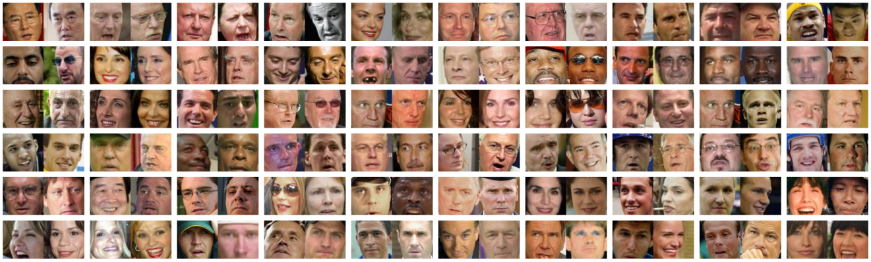
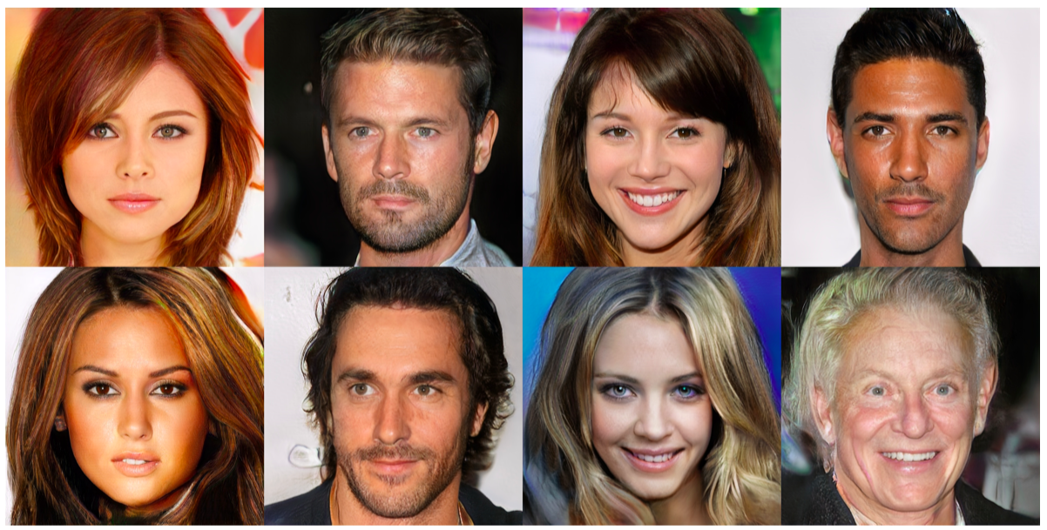
Generative modeling
Given training data, generate new samples from the same distribution
The 60 False-Positive pairs (1.00%) on LFW by DeepFace-ensemble.

Slide 5
Background - Auto encoders
Encoder Decoder architecture
Use for compression
Or throw away the decoder after training use the compressed code for supervised learning tasks (particularly useful in problems with small training set)

Slide 6
Background – Image to Image
https://arxiv.org/pdf/1411.4038.pdf

Slide 7
Two Points to Note
Code to synthesis “Real data” ;
Role in data augmentation
Capability to generate for Neural Networks
The “story” of Police and “fake notes”

Slide 8
GANs
Generative Adversarial Networks
A game between two players:
Discriminator D
Generator G
D tries to discriminate between:
A sample from the data distribution
A sample from the generator G
G tries to “trick” D by generating samples that are hard for D to distinguish from data.

Slide 9
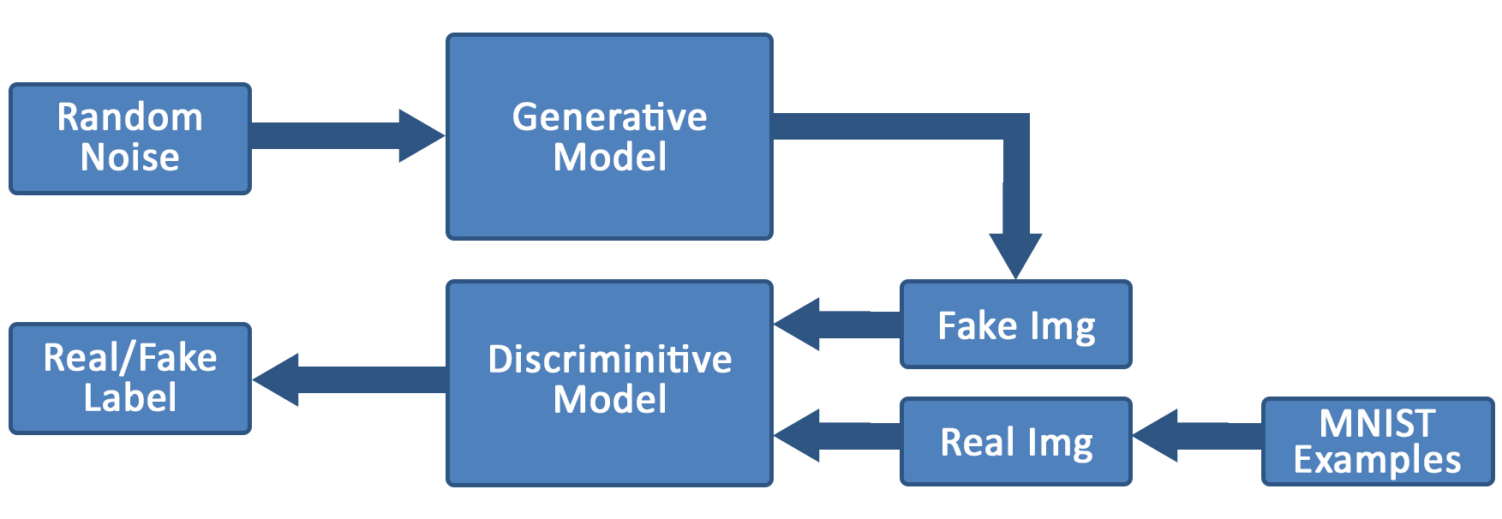
GAN: Network architecture

Slide 10
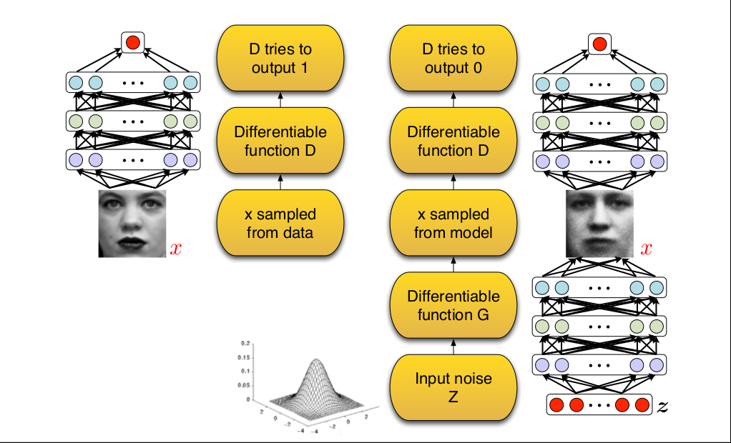
GAN framework
Slide credit: Ian Goodfellow

Slide 11
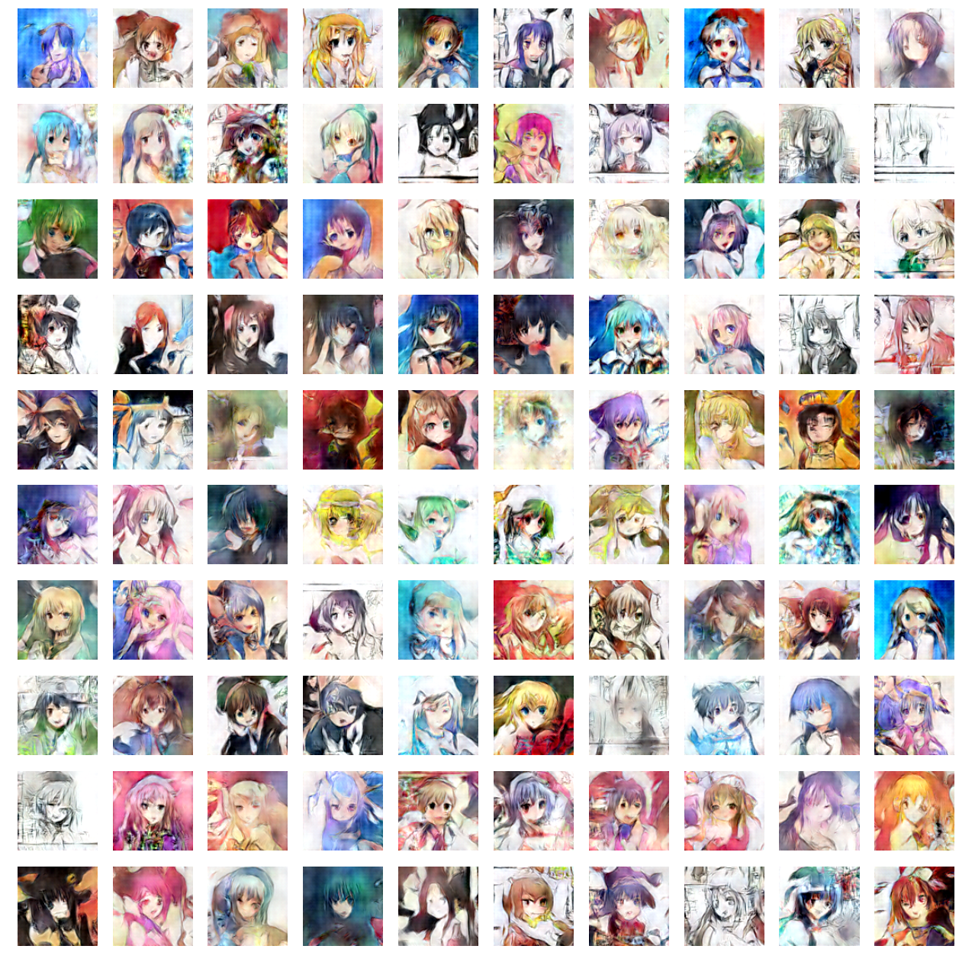
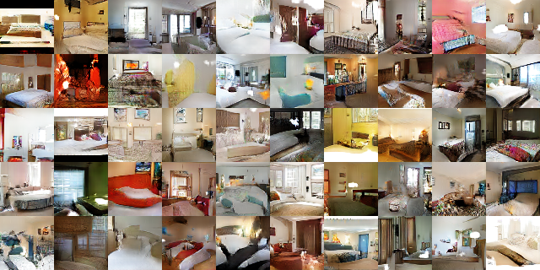
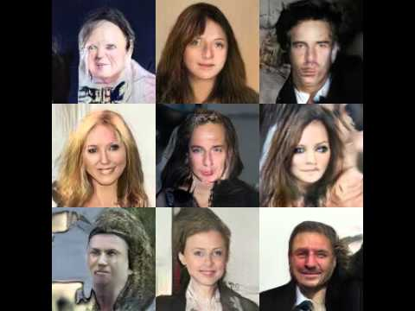
Samples (Synthetic Images)

Slide 12
Results: Progressive GAN (ICLR 2018)

Slide 13
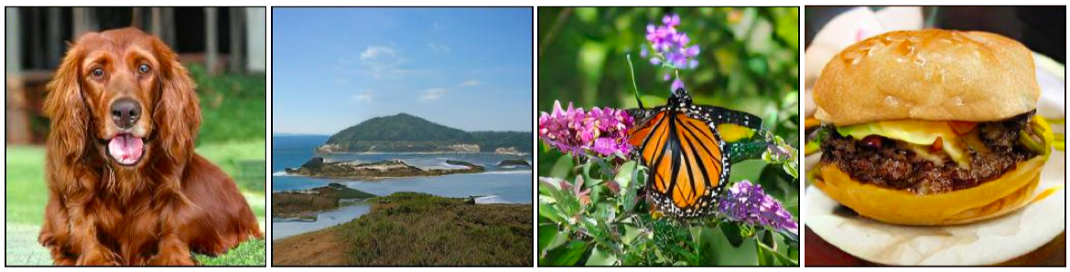
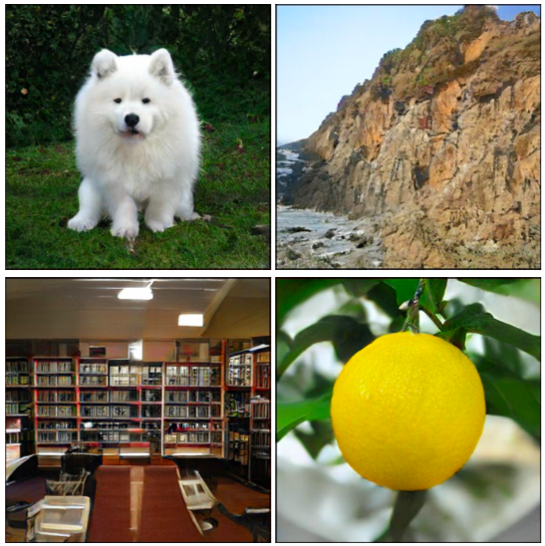
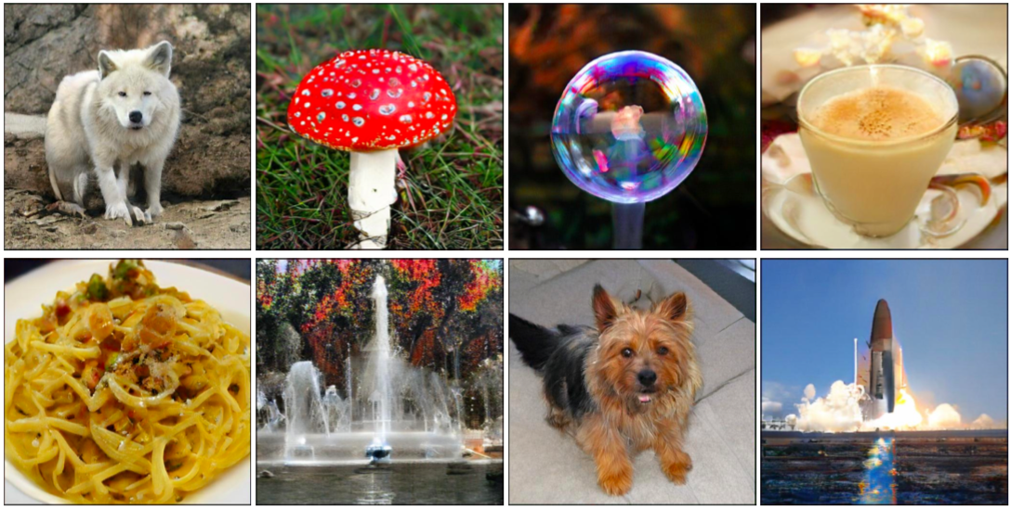
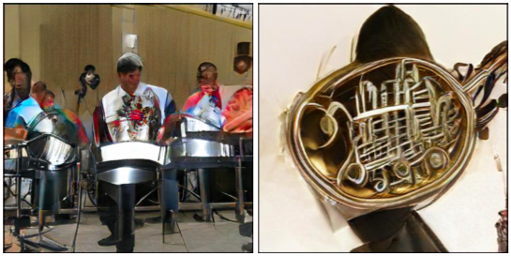
Results: Big GAN (ICLR 2019)

Slide 14
II. Self Supervised Learning

Slide 15
What is Self-Supervised Learning?
Self-Supervised Learning (SSL) is a special type of representation learning that enables learning good data representation from unlabelled dataset.
It is motivated by the idea of constructing supervised learning tasks out of unsupervised datasets. Why?
Data labeling is expensive and thus high-quality labeled dataset is limited.
Learning good representation makes it easier to transfer useful information to a variety of downstream tasks.
e.g. A downstream task has only a few examples.
e.g. Zero-shot transfer to new tasks.

Slide 16
Unsupervised Learning
“We expect unsupervised learning to become far more important in the longer term. Human and animal learning is largely unsupervised: we discover the structure of the world by observing it, not by being told the name of every object.”
LeCun, Bengio, Hinton, Nature 2015
As I've said in previous statements: most of human and animal learning is unsupervised learning. If intelligence was a cake, unsupervised learning would be the cake, supervised learning would be the icing on the cake, and reinforcement learning would be the cherry on the cake. We know how to make the icing and the cherry, but we don't know how to make the cake.
Yann LeCun, March 14, 2016 (Facebook)

Slide 17
Two Popular Ways
Self-prediction
Contrastive learning

Slide 18
Methods for Framing Self-Supervised Learning Tasks
Self-prediction: Given an individual data sample, the task is to predict one part of the sample given the other part.
The part to be predicted pretends to be missing.
?
“Intra-sample” prediction

Slide 19
Methods for Framing Self-Supervised Learning Tasks
Contrastive learning: Given multiple data samples, the task is to predict the relationship among them.
The multiple samples can be selected from the dataset based on some known logics (e.g. the order of words / sentences) or fabricated by altering the original version.
relationship?
“Inter-sample” prediction

Slide 20
The paradigm of learning “foundation” models
Labeled data (e.g. images & labels)
supervised
learning
Pretrained “foundation” network
Transfer
Downstream applications
Unlabeled data (e.g. images)
self-supervised
learning
“Self-supervised learning” is “supervised learning” without specific task annotations.

Slide 21
III Pre-Text Tasks

Slide 22
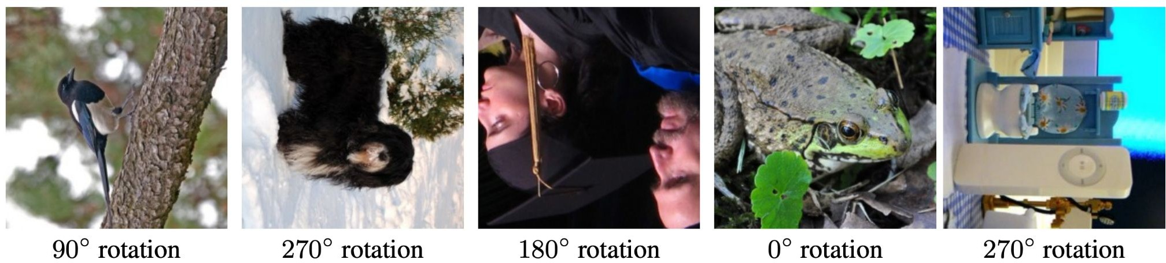
Pretext task: predict rotations
Hypothesis: a model could recognize the correct rotation of an object only if it has the “visual commonsense” of what the object should look like unperturbed.
(Image source: Gidaris et al. 2018)

Slide 23
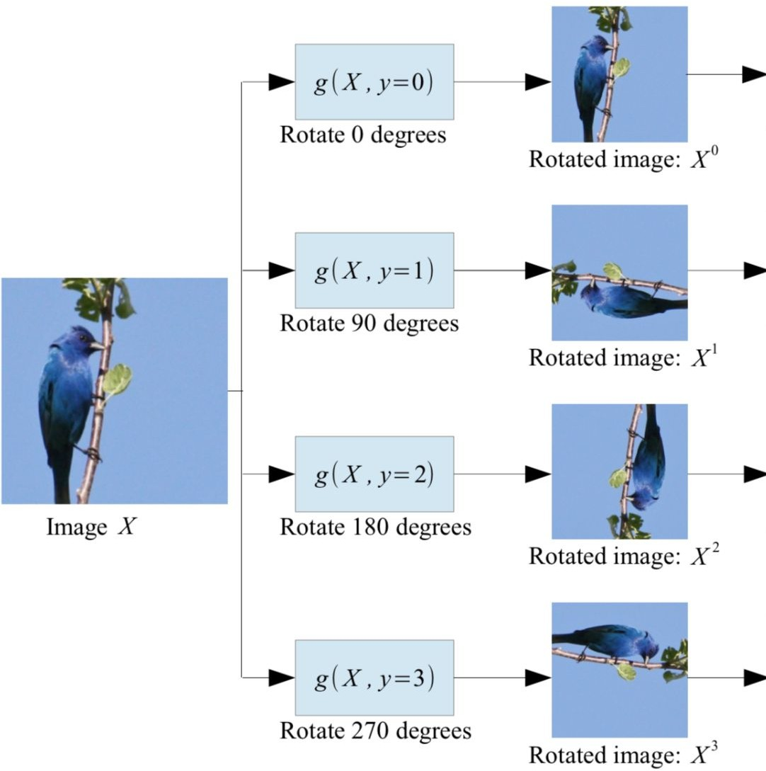
Pretext task: predict rotations
Self-supervised learning by rotating the entire input images.
The model learns to predict which rotation is applied (4-way classification)
(Image source: Gidaris et al. 2018)

Slide 24
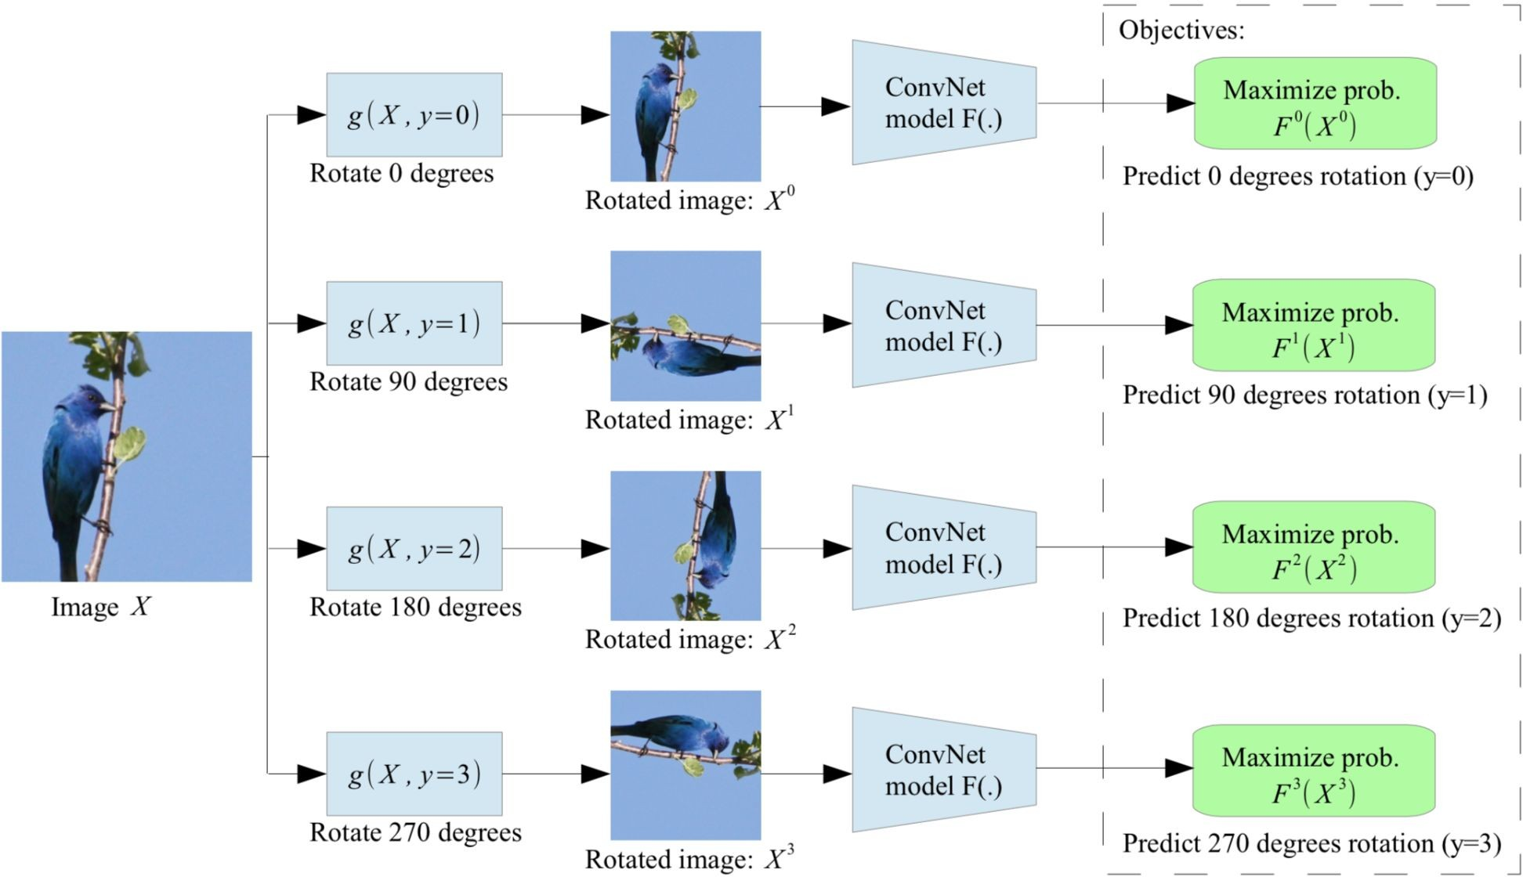
Pretext task: predict rotations
Self-supervised learning by rotating the entire input images.
The model learns to predict which rotation is applied (4-way classification)
(Image source: Gidaris et al. 2018)

Slide 25
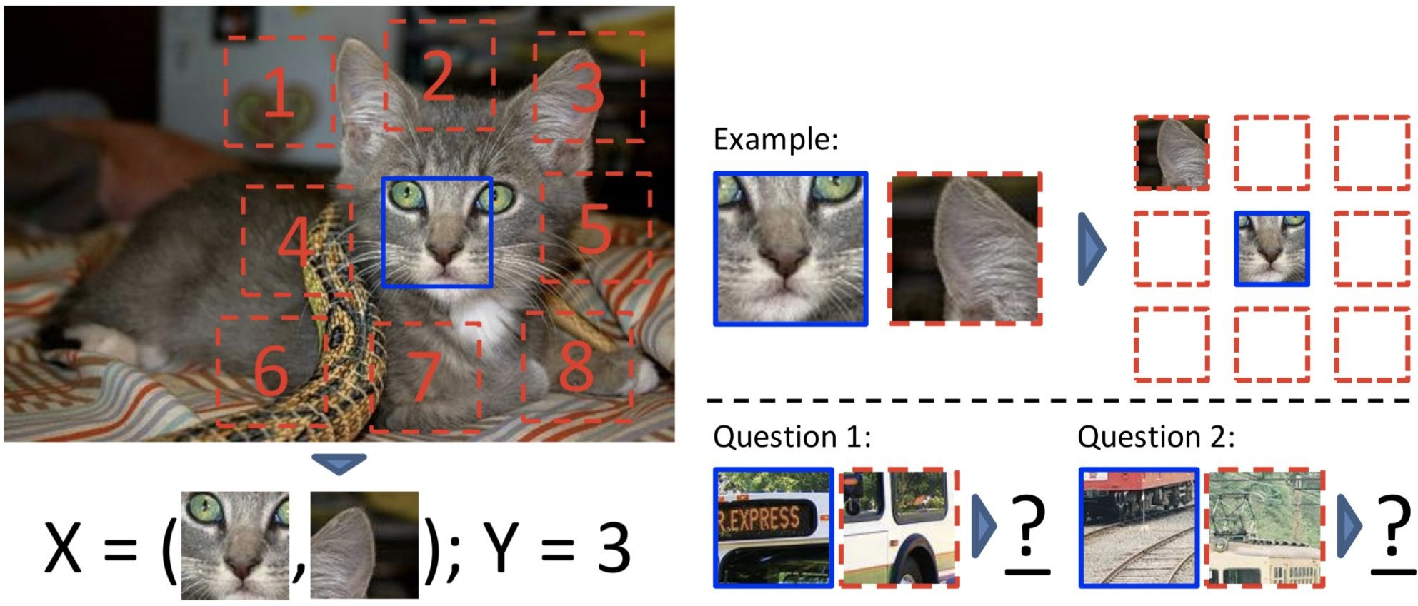
Pretext task: predict relative patch locations
(Image source: Doersch et al., 2015)

Slide 26
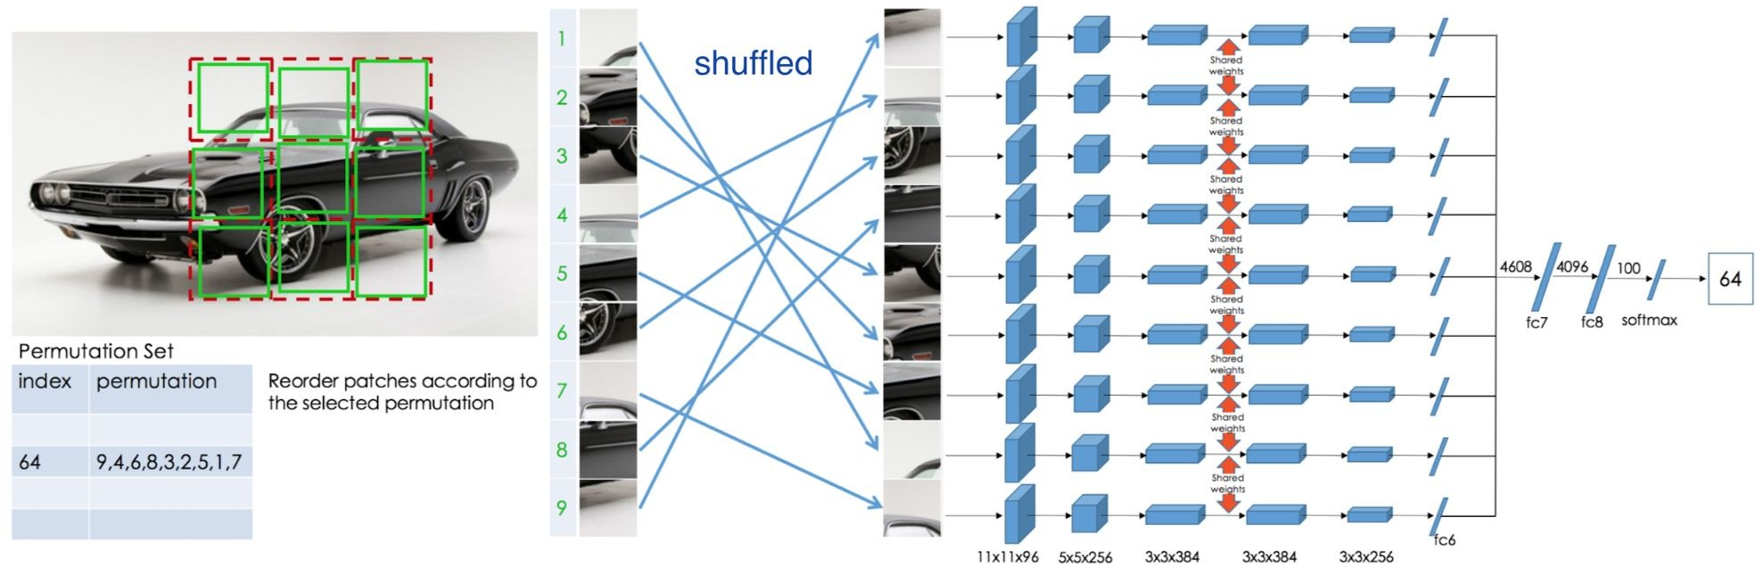
Pretext task: solving “jigsaw puzzles”
(Image source: Noroozi & Favaro, 2016)

Slide 27
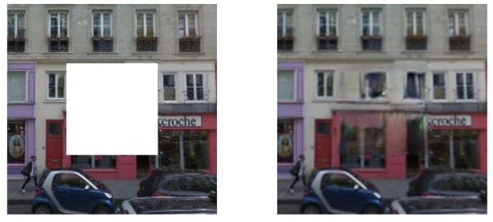
Pretext task: predict missing pixels (inpainting)
Context Encoders: Feature Learning by Inpainting (Pathak et al., 2016)

Slide 28
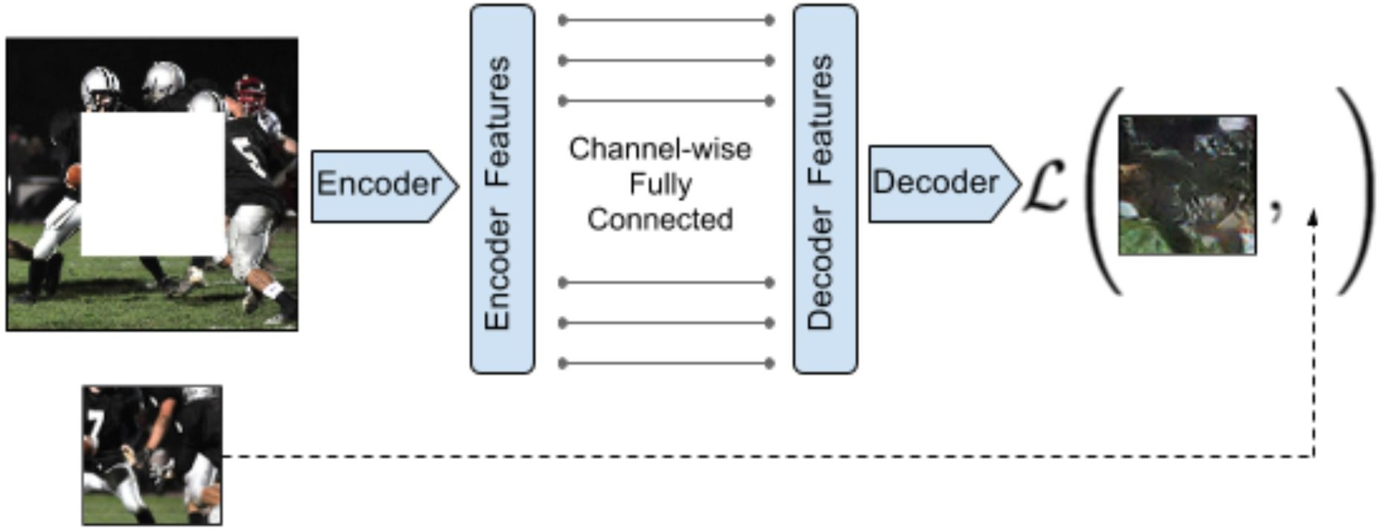
Learning to inpaint by reconstruction
Learning to reconstruct the missing pixels
Source: Pathak et al., 2016

Slide 29
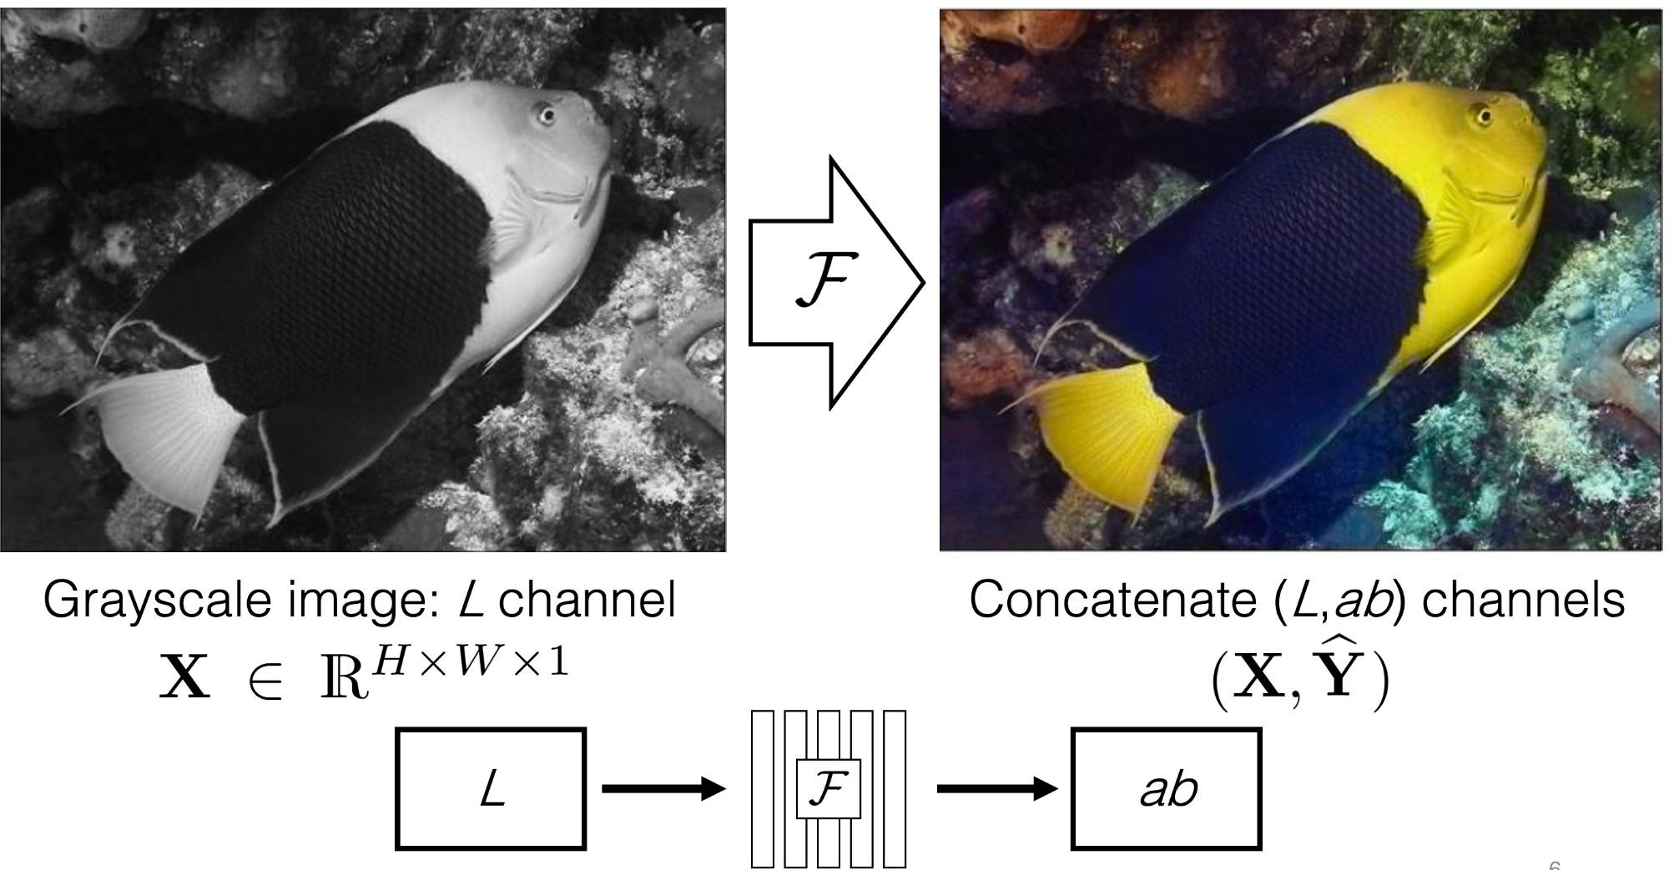
Pretext task: image coloring
Source: Richard Zhang / Phillip Isola

Slide 30
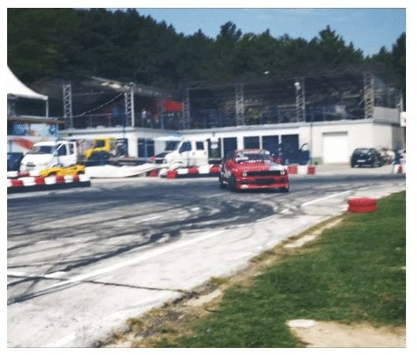
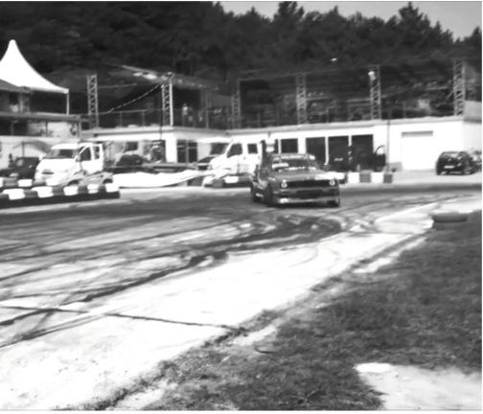
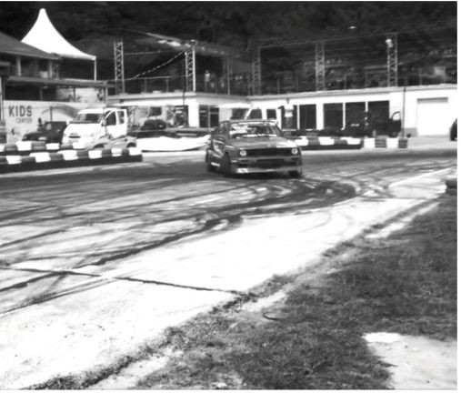
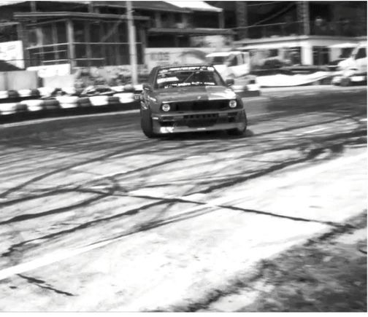





Pretext task: video coloring
Idea: model the temporal coherence of colors in videos
reference frame how should I color these frames?
...
t = 1 t = 2 t = 3
t = 0
Hypothesis: learning to color video frames should allow model to learn to track regions or objects without labels!
Source: Vondrick et al., 2018

Slide 31
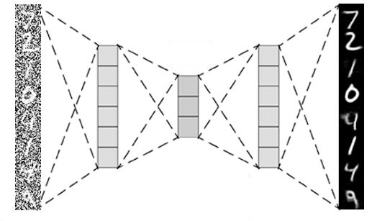
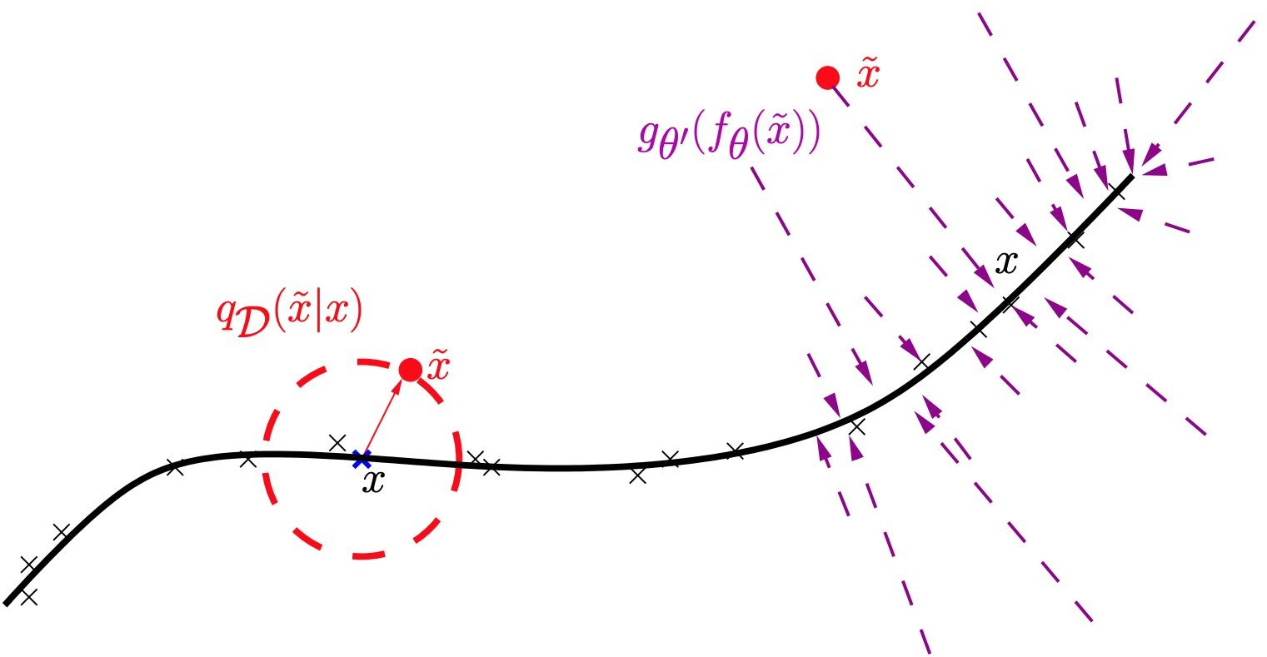
Autoencoder: Self-Supervised Learning-Vision in Early Days
Denoising Autoencoder (Vincent et al. 2008)
(Vincent et al. 2008)

Slide 32
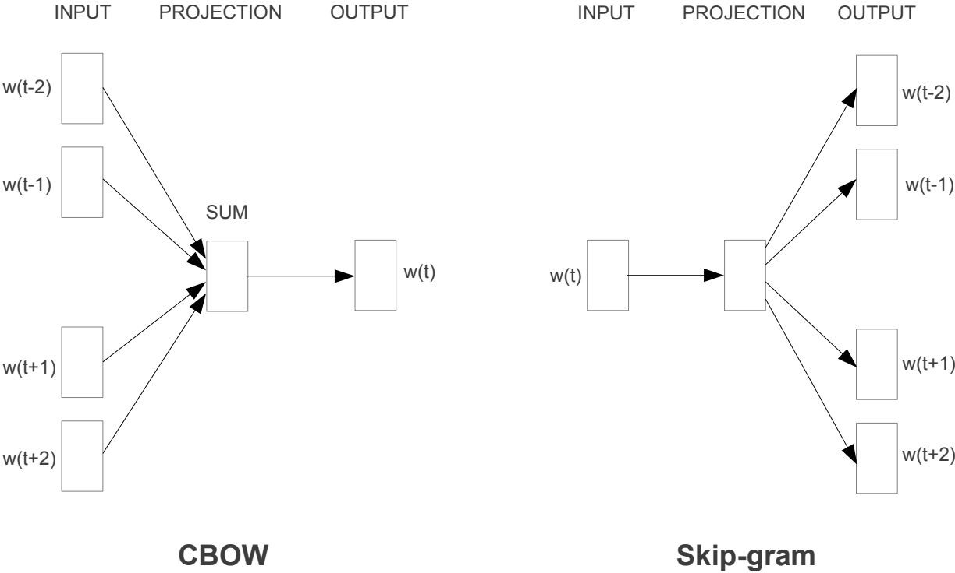
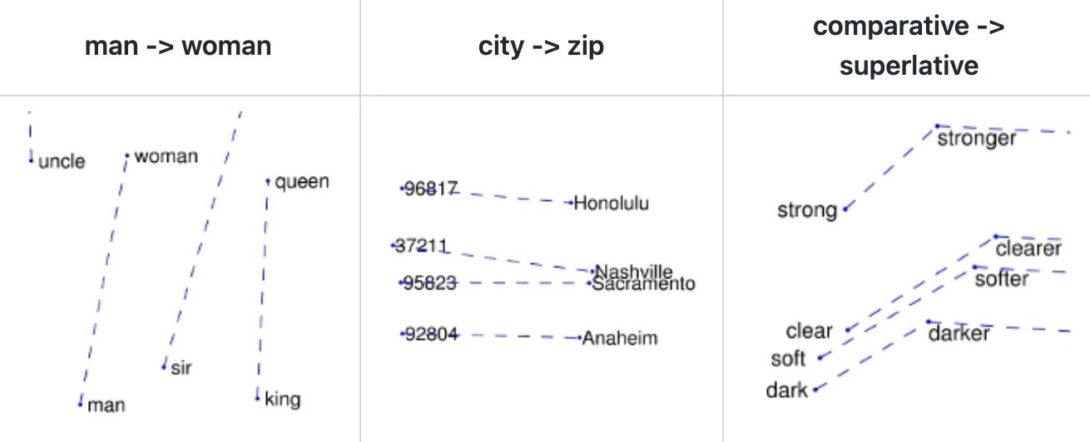
Word2Vec: Self-Supervised Learning for Language
Word embeddings to map words to vectors
CBOW & Skip-gram (Mikolov et al. 2013)
Neighboring words → middle word (CBOW)
Word → neighboring words (skip-gram)
GloVe (Pennington et al. 2014)
Log-bilinear on word co-occurrences
(Mikolov et al. 2013; Pennington et al. 2014)

Slide 33
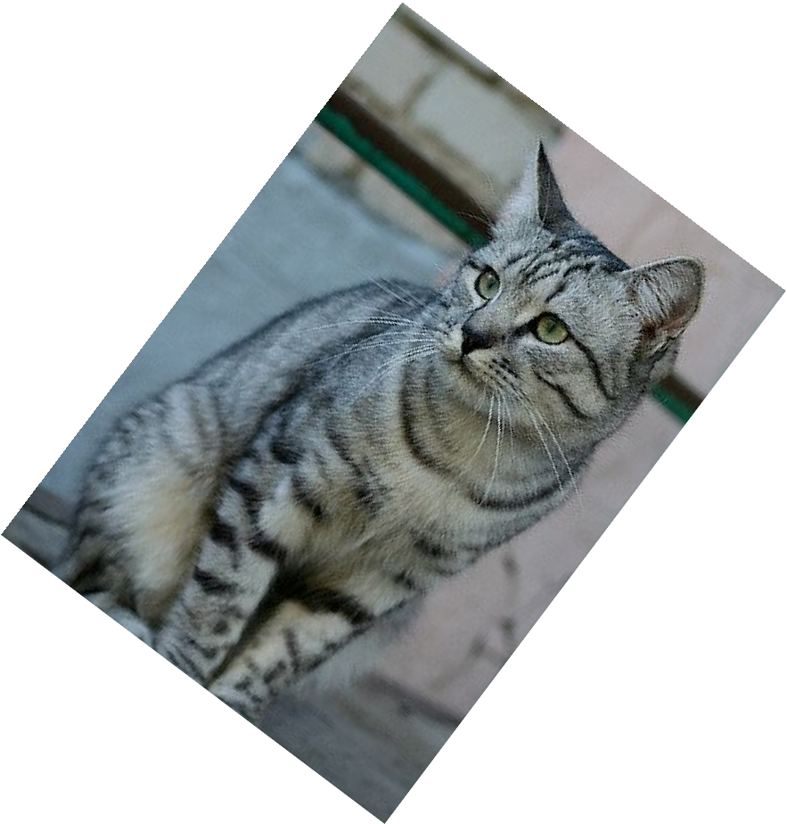
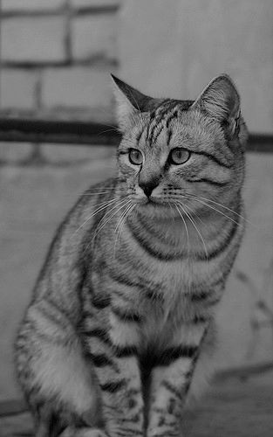
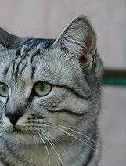
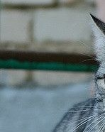
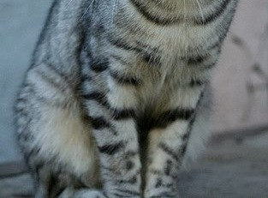
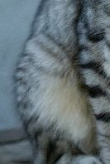
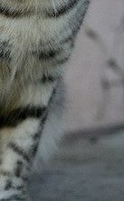
Pretext tasks from image transformations
?
θ=?
image completion rotation prediction “jigsaw puzzle”
colorization
Learned representations may be tied to a specific pretext task! Can we come up with a more general pretext task?

Slide 34






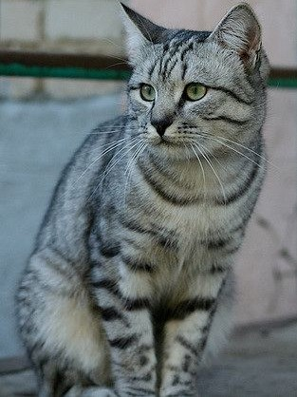

We know samples are same
?
θ=?
same object

Slide 35
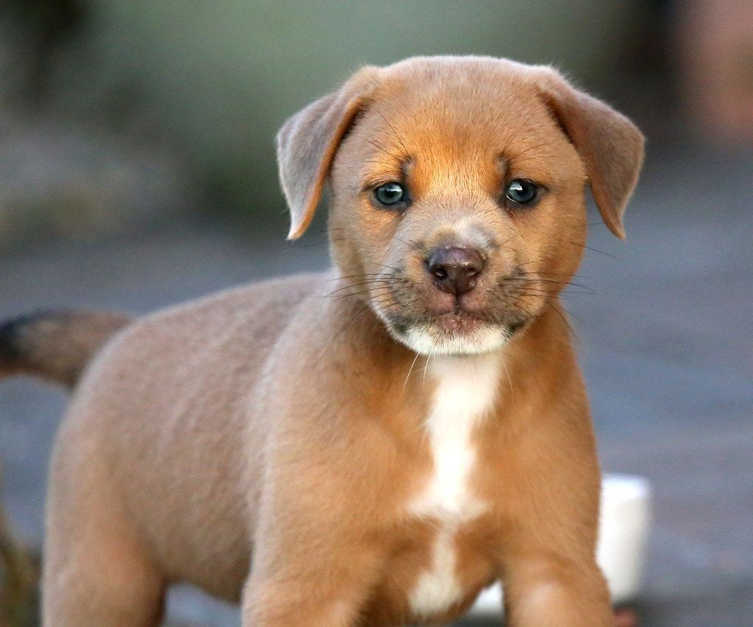


We know samples are same and different
?
θ=?
same object
attract
reject
different object

Slide 36
IV Contrastive Leaning

Slide 37
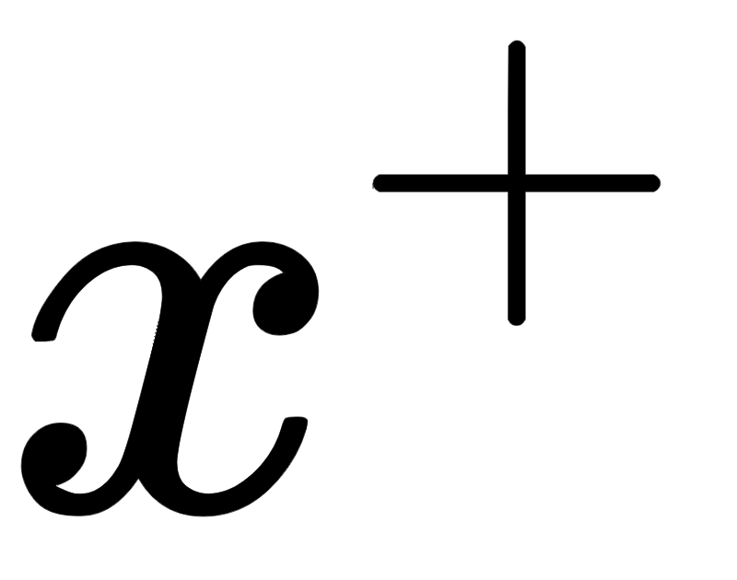

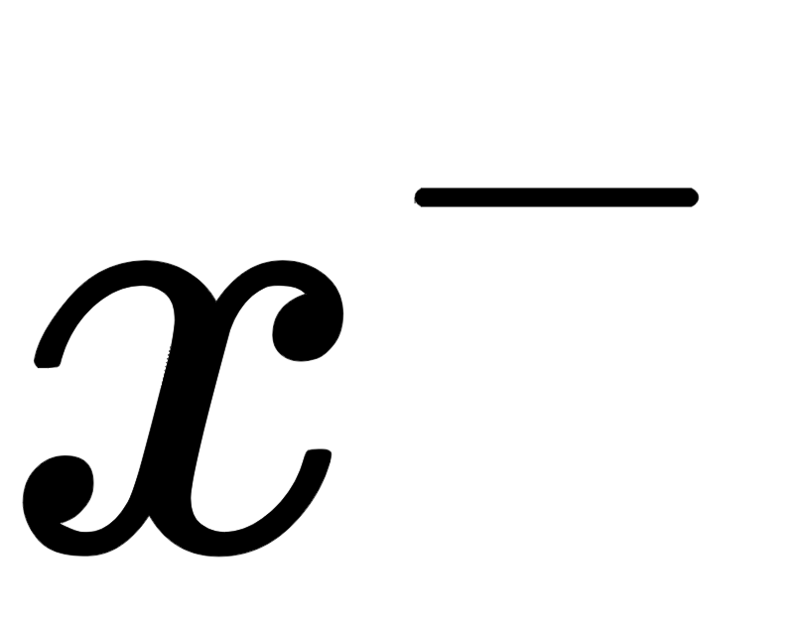
Contrastive Representation Learning
?
θ=?
reference positive negative
May 17, 2022

Slide 38
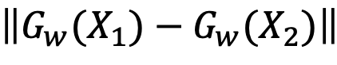
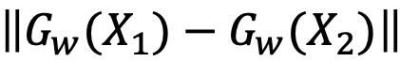
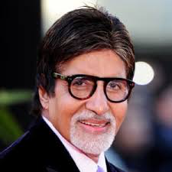
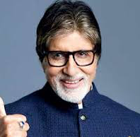
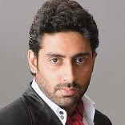
Siamese Architecture/Loss
Make this smaller
Make this larger
Only pair-wise Labels
Similarity Metric:
D_{w}(X₁, X₂)
Have shared weights
Training in batches
D_{w}
D_{w}
G_{w}(X₁)
W
G_{w}(X₂)
G_{w}(X₁)
W
G_{w}(X₂)
X₁
X₂
X₁
X₂

Slide 39
Contrastive Learning
The goal of contrastive representation learning is to learn such an embedding space in which similar sample pairs stay close to each other while dissimilar ones are far apart.
After learning

Slide 40
Contrastive Learning: Inter-Sample Classiﬁcation
The goal of contrastive representation learning is to learn such an embedding space in which similar sample pairs stay close to each other while dissimilar ones are far apart.
Given both similar (“positive”) and dissimilar (“negative”) candidates, to identify which ones are similar to the anchor data point is a classiﬁcation task.
There are creative ways to construct a set of data point candidates:
The original input and its distorted version
Data that captures the same target from different views

Slide 41
Contrastive Learning: Inter-Sample Classiﬁcation
Common loss functions:
Contrastive loss (Chopra et al. 2005)
Triplet loss (Schroff et al. 2015; FaceNet)
Lifted structured loss (Song et al. 2015)
Multi-class n-pair loss (Sohn 2016)
Noise contrastive estimation (“NCE”; Gutmann & Hyvarinen 2010)
InfoNCE (van den Oord, et al. 2018)
Soft-nearest neighbors loss (Salakhutdinov & Hinton 2007, Frosst et al. 2019)

Slide 42
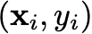
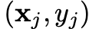
Contrastive Learning: Inter-Sample Classiﬁcation
Contrastive loss (Chopra et al. 2005): Works with labelled dataset.
Encodes data into an embedding vector such that examples from the same class have similar embeddings and samples from different classes have different ones.
Given two labeled data pairs and :
minimize
maximize

Slide 43
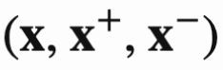
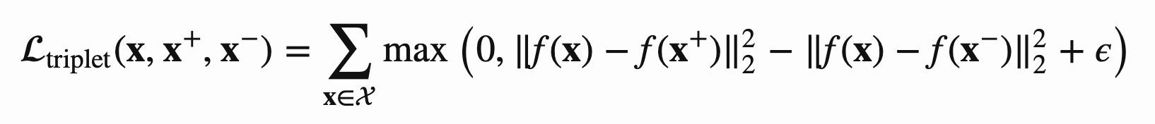
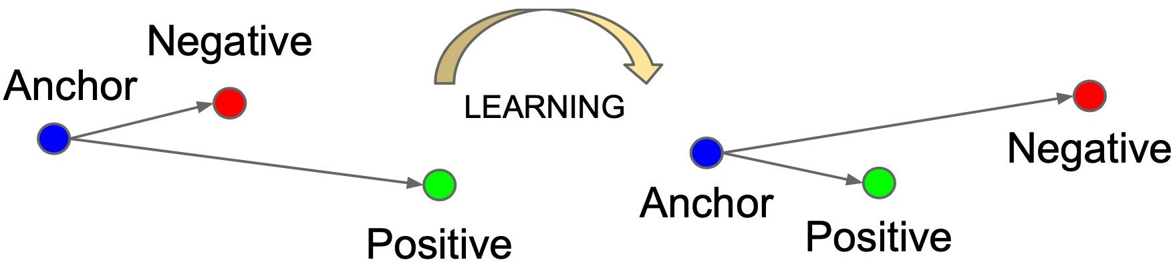
Contrastive Learning: Inter-Sample Classiﬁcation
Triplet loss (Schroff et al. 2015): learns to minimize the distance between the anchor x and positive x+ and maximize the distance between the anchor x and negative x- at the same time.
Given a triplet input ,
(Schroff et al. 2015)

Slide 44
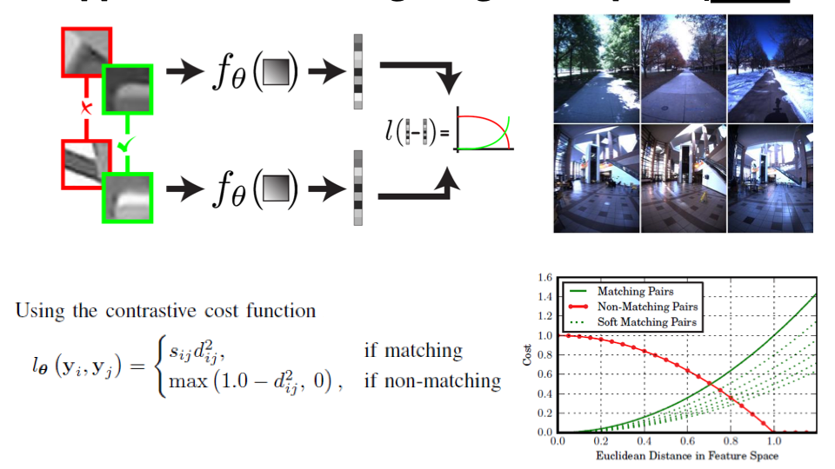
Application: Learning to Match Siamese Network
IROS 2014

Slide 45
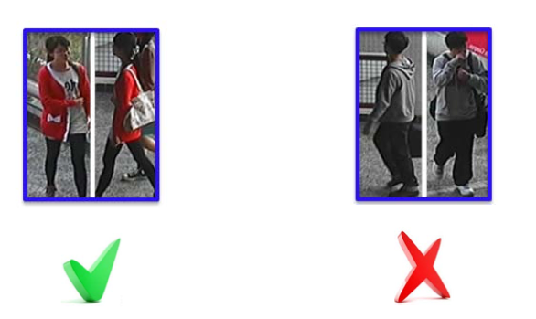


Person identification
CUHK03 Data set

Slide 46
V Summary

Slide 47
Summary
Fully Supervised Learning is not practical in all situations
Availability of the annotation
Knowledge of the task ahead of time
Self Supervised Learning provided an “unsupervised” learning
Pretraining
Two main ways
Pretext Tasks
Contrastive Learning
Success stories
Many in language
Impressive results in vision competing with Fully Supervised

Slide 48
Thank you!!

